Slide 1
Music Pad
Florian Shaban and Michael Gonzales

Slide 2
Motivation
We wanted to create an app that would make it easier for Musicians to create and share music.
Simpler and more efficient organization of musical recordings.

Slide 3
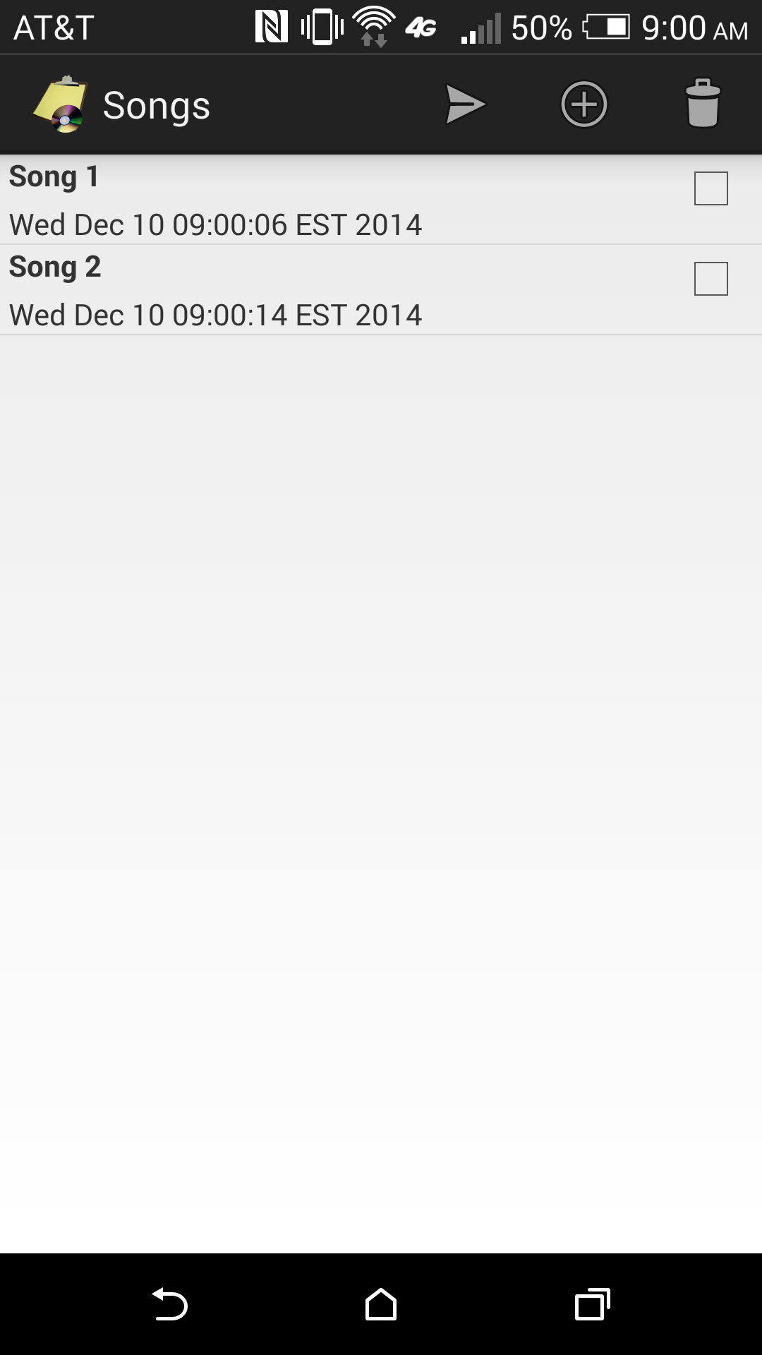
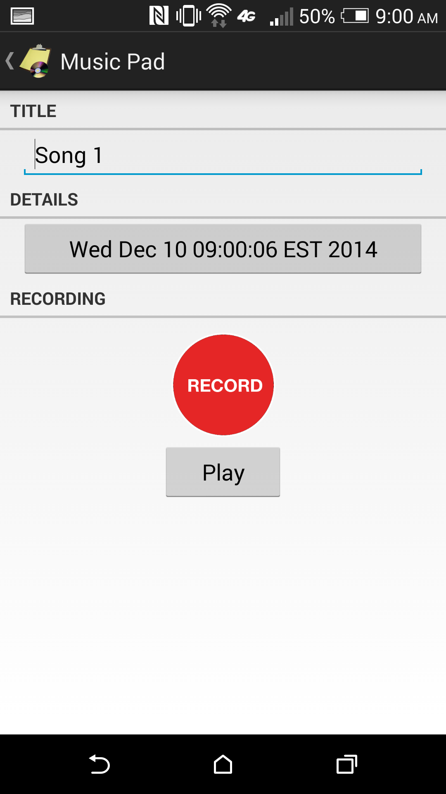
Design

Slide 4
The List View
Menu Items
Array of Song Objects
Permanent save of data in Shared Preferences
Gson, Json

Slide 5
The Song Object
Edit Text(updates filepath)
AudioRecord Class
Thread Implemented
Writes Audio Data to file in a raw Format
AudioTrack Class
Service Implemented
Playback Raw Audio Data from File

Slide 6
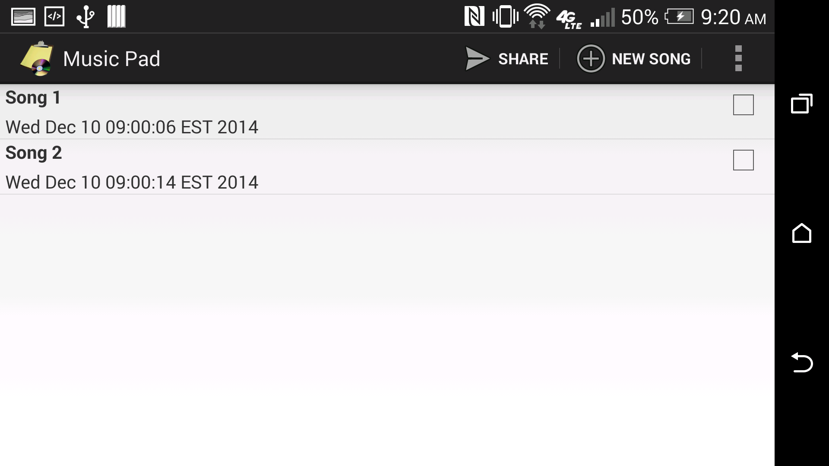
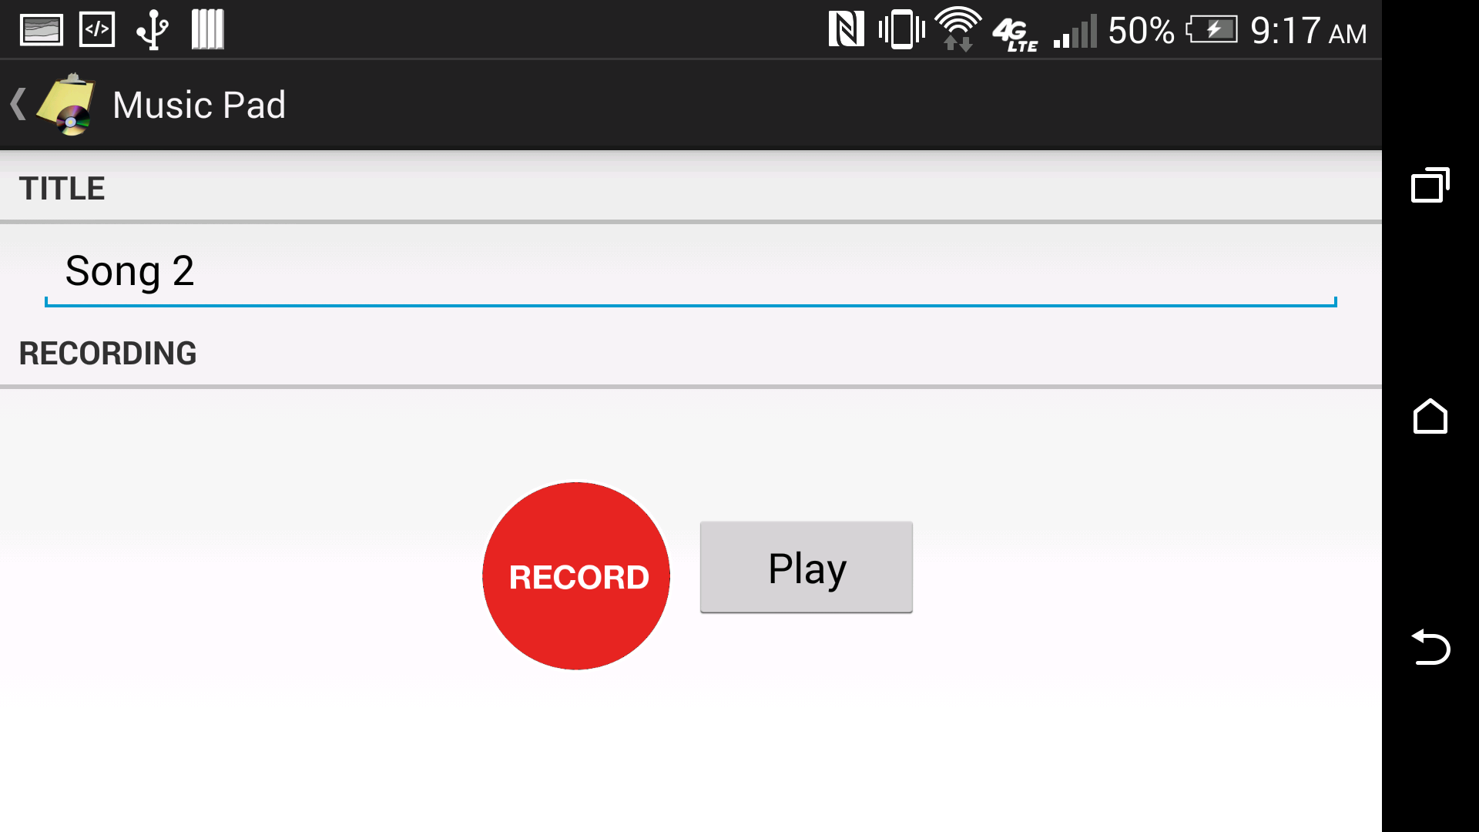
Horizontal Layouts

Slide 7
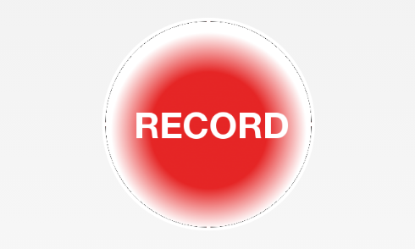
Custom Button
Custom Record Button with two states
Recording and Not Recording
When Not Recording Activates Record and switches state
When Recording stop recording and switches state

Slide 8
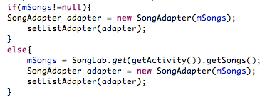

Lessons Learned
Implementation of Permanent Save must take into account new Installers
Must keep in mind Limitations of Hardware

Slide 9
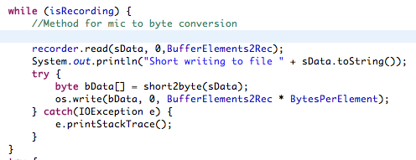
Future Work
A more robust UI
NFC sharing and Sharing in general.
Requires Converting from raw to a more accessible format
(Preferably Wav)
Sound Editing Functionality
Benefit of recording in raw.

Slide 10
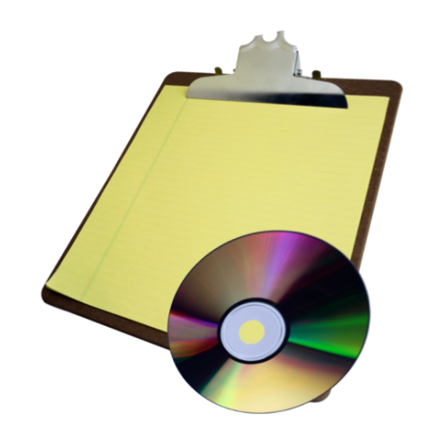

Thank You
From the Developers of MusicPad
Florian Shaban & Michael Gonzales

